Slide 1

Program Evaluation and Review Technique (PERT)
CSE347 – Information System Analysis and Design

Slide 2
Network Diagram Rules
Network Diagram
Network Diagram is a project management tool to depict the project activities, their durations and their dependencies. It is used to develop a schedule and to determine critical paths.
Project network or project diagram can be constructed by using the following rules:
Node 1 represents the start of the project. An arc should lead from node 1 to represent each activity that has no predecessors.
A node (called the finish node) representing the completion of the project should be included in the network.
Number the nodes in a way that the node representing the completion of an activity has larger number that the beginning of the activity
An activity should not be represented by more than one arc in the network.
Two nodes can be connected by at most one arc.

Slide 3
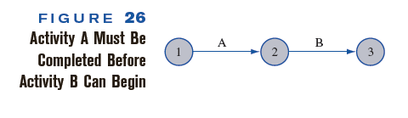

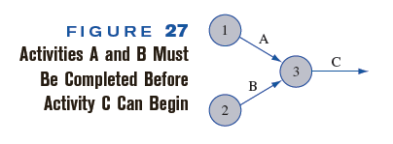
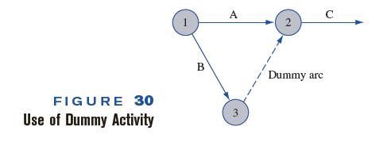
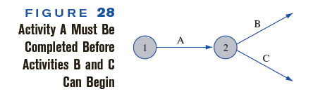
Network Diagram Rules

Slide 4
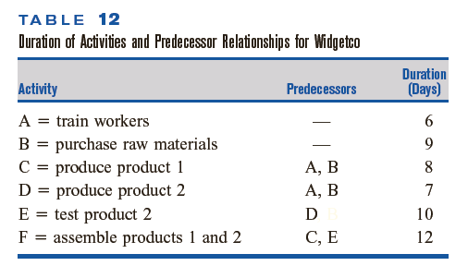
Example

Slide 5
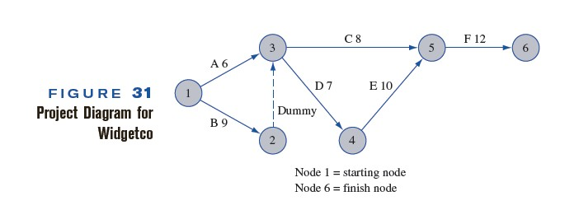
Network Diagram

Slide 6
Example
Activity | Predecessor | Duration
A | --- | 1
B | A | 3
C | A | 4
D | A | 3
E | D | 2
F | B, C, E | 4
G | D | 9
H | D | 5
I | H | 2
J | F, G, I | 2

Slide 7
3
Dummy(0)
B(3)
1
A(1)
2
C(4)
5
F(4)
7
J(2)
8
E(2)
G(9)
D(3)
I(2)
4
H(5)
6

Slide 8
Latest Time
Earliest Time
3
B(3)
Dummy(0)
1
A(1)
2
C(4)
5
F(4)
7
J(2)
8
E(2)
G(9)
D(3)
I(2)
4
H(5)
6

Slide 9
Latest Time
Earliest Time
6
4
3
0
0
1
1
B(3)
Dummy(0)
9
6
13
13
15
15
1
A(1)
2
C(4)
5
F(4)
7
J(2)
8
E(2)
G(9)
D(3)
I(2)
4
H(5)
4
4
6
11
9

Slide 10
Critical Activity: An activity is said to be critical if the total float (TF_{ij}) for any activity (ij) is zero
Critical Path condition:
ES_{i} = LF_{i}
ES_{j} = LF_{j}
ES_{j} – ES_{i} = LF_{j} – LF_{i} = T_{ij}

Slide 11
Latest Time
Earliest Time
6
4
3
0
0
1
1
B(3)
Dummy(0)
9
6
13
13
15
15
1
A(1)
2
C(4)
5
F(4)
7
J(2)
8
E(2)
G(9)
D(3)
I(2)
4
H(5)
4
4
6
Identify critical Activity
11
9

Slide 12
Three-Point Estimating and PERT Distribution (Cost & Time Estimation)
Estimating time, efforts and cost is one of the most critical parts of project management. One of the estimation techniques suggested in the PMI Project Management Body of Knowledge is the three-point estimate used with the triangular, Beta or PERT distribution.
What Is the Three-Point Estimation Technique?
The three-point estimate is a simple yet useful approach to estimating the time or cost of work items.
The technique involves three different estimates that are usually obtained from subject matter experts:
Optimistic estimate – The expected amount of work or time needed to perform an activity assuming no impediments occur and everything is going smooth. It represents the so-called best-case scenario.
Pessimistic estimate – The pessimistic point is based on the assumption that the opposite was true – it represents the worst–case scenario.
Most likely estimate – The most likely case, it is the estimation of work or time that is deemed to be the most realistic.

Slide 13
How Is Three-Point Estimate Calculated?
The Triangular Distribution
The simple yet commonly used calculation involves the average or mean of the 3 estimated values. The formula is:
E = (O + M + P) / 3
where:
E = Expected amount of time or cost,
O = Optimistic estimate,
M = Most likely estimate,
P = Pessimistic estimate.
The PERT Beta Distribution
In this method, the most likely estimate receives a multiplier of 4 while the overall divisor is increased to 6. The formula is as follows:
E = (O + 4*M + P) / 6
where:
E = Expected amount of time or cost,
O = Optimistic estimate,
M = Most likely estimate,
P = Pessimistic estimate.

Slide 14
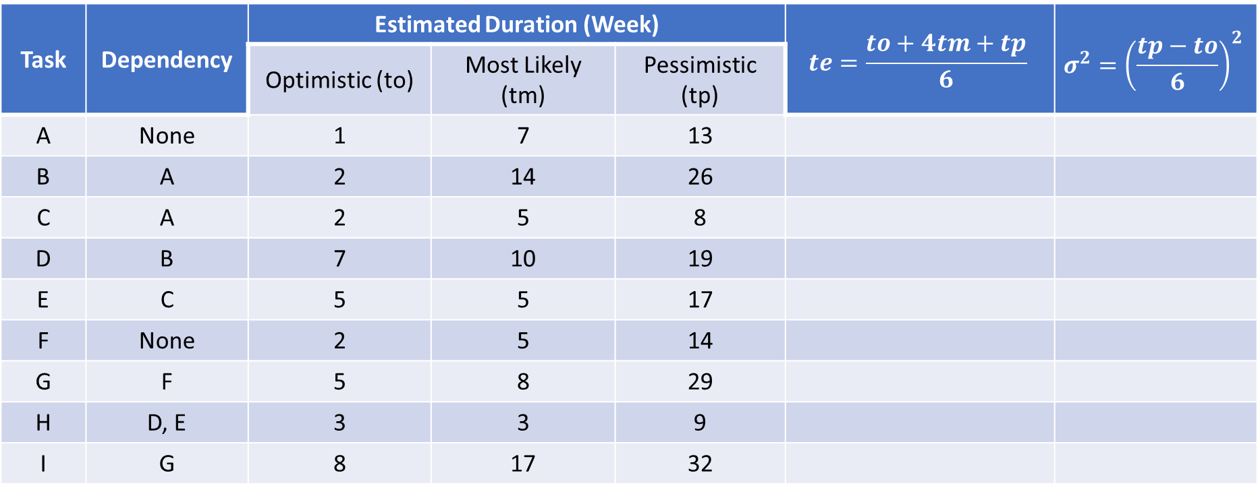
Example: PERT
The following table shows the job of a network along with their time estimates
Task | Dependency | Estimated Duration (Week) |  |  | $$te=\frac{to+4tm+tp}{6}$$ | $$σ^{2}={\left(\frac{tp−to}{6}\right)}^{2}$$
 |  | Optimistic (to) | Most Likely (tm) | Pessimistic (tp)
A | None | 1 | 7 | 13
B | A | 2 | 14 | 26
C | A | 2 | 5 | 8
D | B | 7 | 10 | 19
E | C | 5 | 5 | 17
F | None | 2 | 5 | 14
G | F | 5 | 8 | 29
H | D, E | 3 | 3 | 9
I | G | 8 | 17 | 32

Slide 15
Find solution of the following questions
Draw the project Network
Find the expected duration and variance of each activity
Calculate the earliest and latest occurrence for each event
Calculate expected project length
Calculate the variance and standard deviations of the project length
Find the probability of the project completing in 40 days

Slide 16
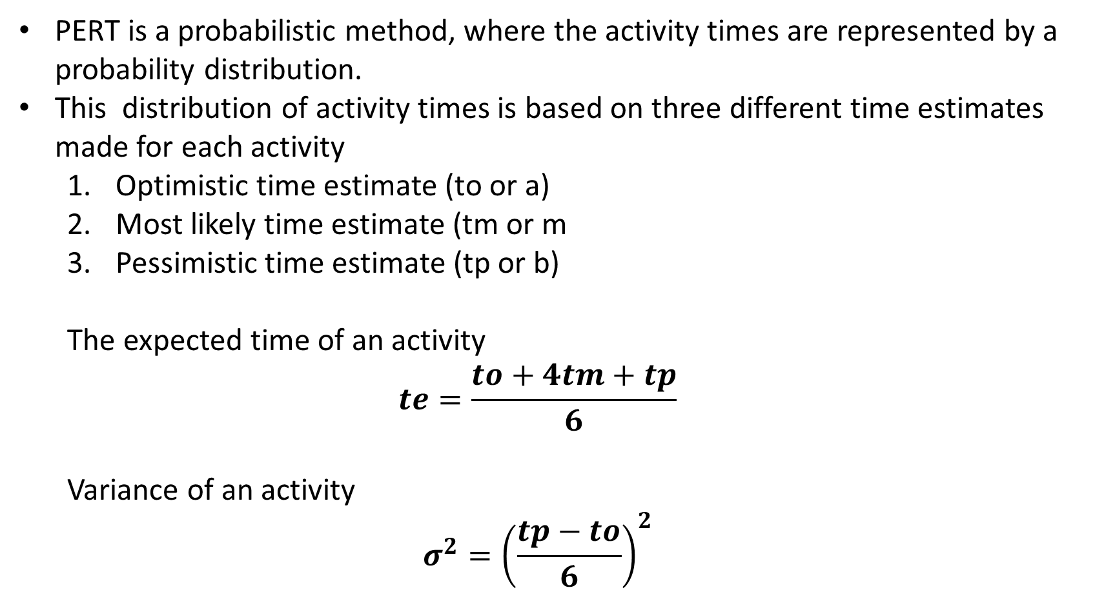
PERT is a probabilistic method, where the activity times are represented by a probability distribution.
This distribution of activity times is based on three different time estimates made for each activity
Optimistic time estimate (to or a)
Most likely time estimate (tm or m
Pessimistic time estimate (tp or b)
The expected time of an activity
$$te=\frac{to+4tm+tp}{6}$$
Variance of an activity
$$σ^{2}={\left(\frac{tp−to}{6}\right)}^{2}$$

Slide 17
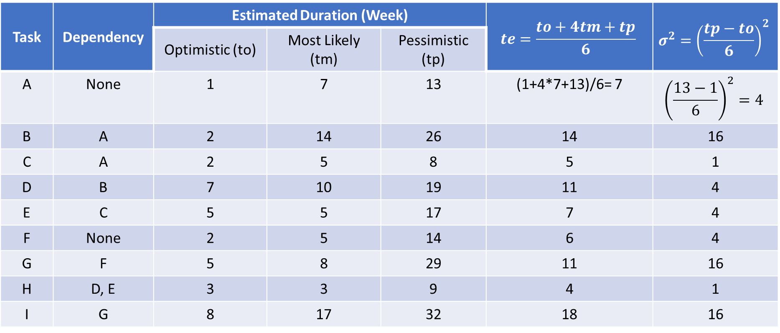
Example: PERT
The following table shows the job of a network along with their time estimates
Task | Dependency | Estimated Duration (Week) |  |  | $$te=\frac{to+4tm+tp}{6}$$ | $$σ^{2}={\left(\frac{tp−to}{6}\right)}^{2}$$
 |  | Optimistic (to) | Most Likely (tm) | Pessimistic (tp)
A | None | 1 | 7 | 13 | (1+4*7+13)/6= 7 | $${\left(\frac{13−1}{6}\right)}^{2}=4$$
B | A | 2 | 14 | 26 | 14 | 16
C | A | 2 | 5 | 8 | 5 | 1
D | B | 7 | 10 | 19 | 11 | 4
E | C | 5 | 5 | 17 | 7 | 4
F | None | 2 | 5 | 14 | 6 | 4
G | F | 5 | 8 | 29 | 11 | 16
H | D, E | 3 | 3 | 9 | 4 | 1
I | G | 8 | 17 | 32 | 18 | 16

Slide 18
Latest Time
Earliest Time
3
D(11)
B(14)
2
5
H(4)
A(7)
C(5)
E(7)
1
4
8
F(6)
I(18)
6
G(11)
7

Slide 19
Latest Time
Earliest Time
21
7
3
32
D(11)
B(14)
2
5
36
0
H(4)
12
A(7)
C(5)
E(7)
1
4
8
F(6)
6
17
I(18)
6
G(11)
7

Slide 20
Latest Time
Earliest Time
21
21
7
7
3
32
32
D(11)
B(14)
2
5
36
36
0
0
H(4)
25
12
A(7)
C(5)
E(7)
1
4
8
F(6)
7
6
18
17
I(18)
6
G(11)
7

Slide 21
Latest Time
Earliest Time
21
21
7
7
3
32
32
D(11)
B(14)
2
5
36
36
0
0
H(4)
25
12
A(7)
C(5)
E(7)
1
4
8
F(6)
7
6
18
17
I(18)
6
G(11)
7

Slide 22

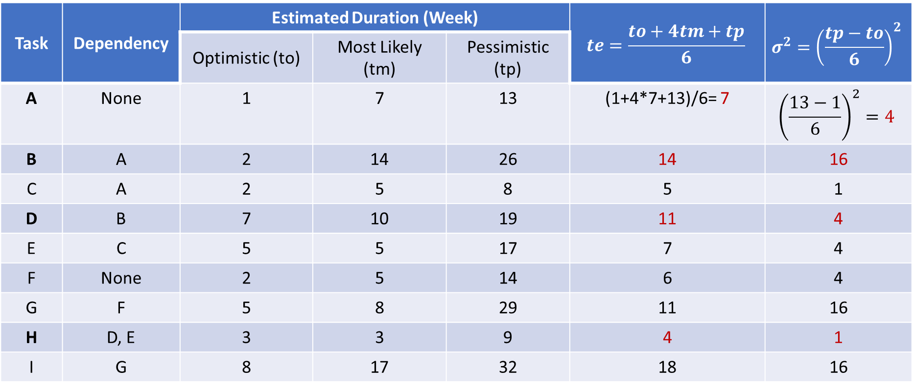

Task | Dependency | Estimated Duration (Week) |  |  | $$te=\frac{to+4tm+tp}{6}$$ | $$σ^{2}={\left(\frac{tp−to}{6}\right)}^{2}$$
 |  | Optimistic (to) | Most Likely (tm) | Pessimistic (tp)
A | None | 1 | 7 | 13 | (1+4*7+13)/6= 7 | $${\left(\frac{13−1}{6}\right)}^{2}=4$$
B | A | 2 | 14 | 26 | 14 | 16
C | A | 2 | 5 | 8 | 5 | 1
D | B | 7 | 10 | 19 | 11 | 4
E | C | 5 | 5 | 17 | 7 | 4
F | None | 2 | 5 | 14 | 6 | 4
G | F | 5 | 8 | 29 | 11 | 16
H | D, E | 3 | 3 | 9 | 4 | 1
I | G | 8 | 17 | 32 | 18 | 16
Expected Project Length: A + B + D + H = 7+14+11+4 = 36 weeks
Critical Path: 1 – 2 – 3 – 5 – 8
Project Length variance, $σ^{2}$ = 4 + 16 + 4 + 1 = 25
Project Length standard deviation, $σ$ = 5

Slide 23
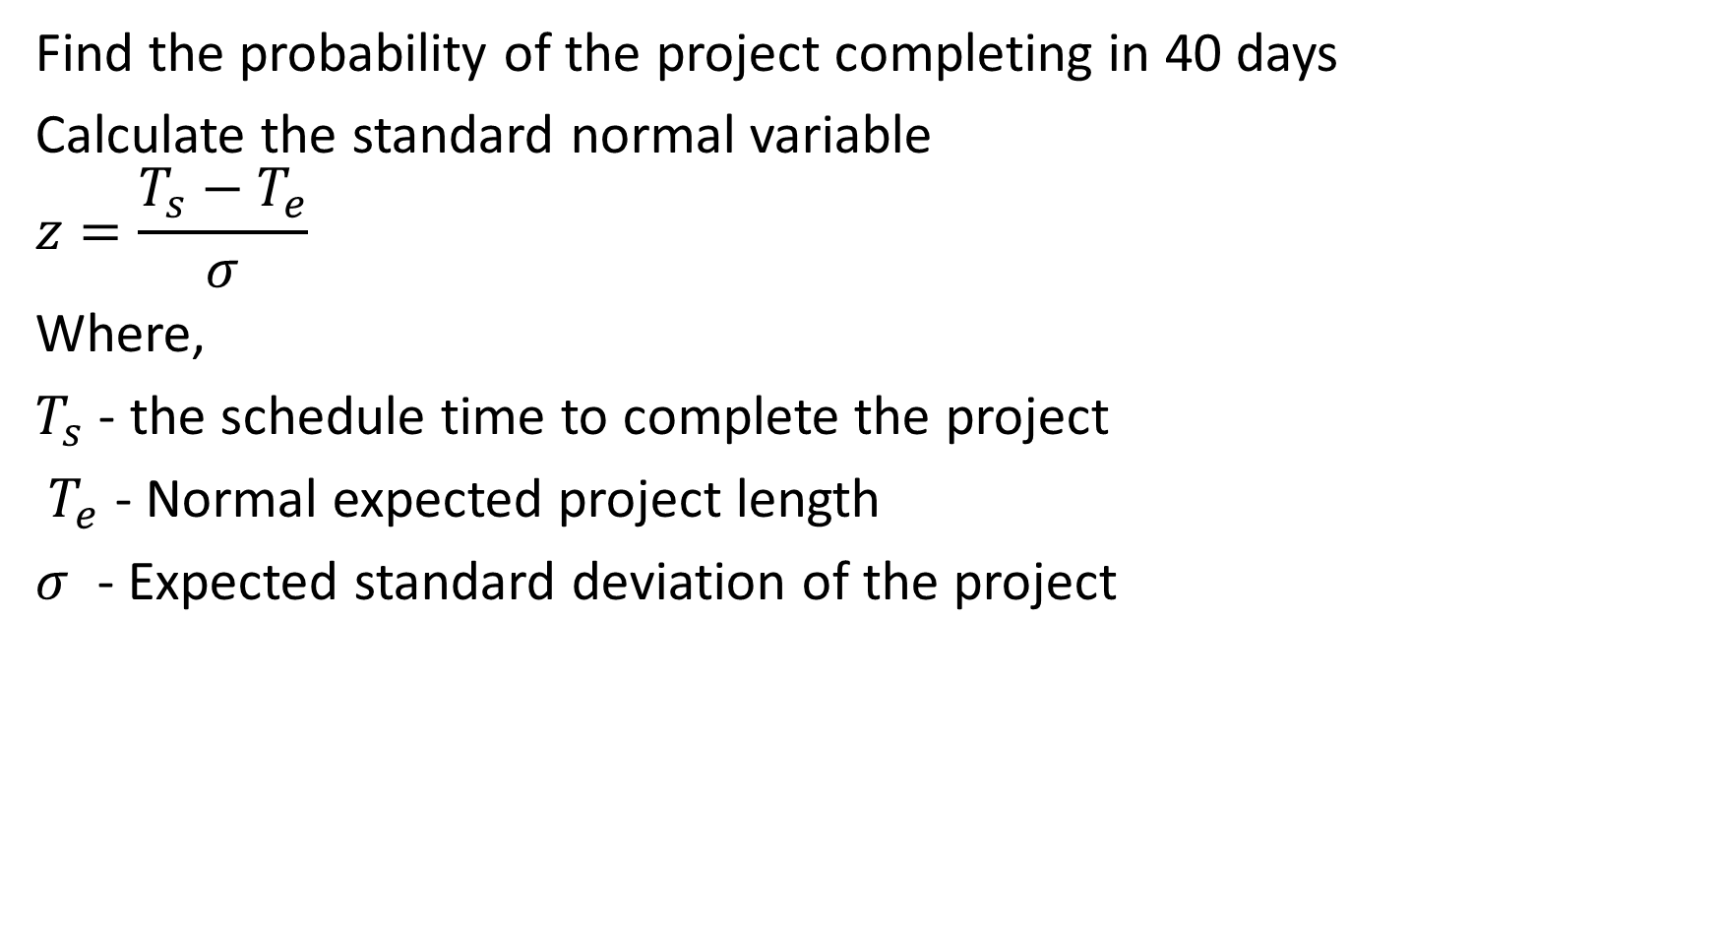
Find the probability of the project completing in 40 days
Calculate the standard normal variable
$$z=\frac{T_{s}−T_{e}}{σ}$$
Where,
$T_{s}$ - the schedule time to complete the project
$T_{e}$ - Normal expected project length
$σ$ - Expected standard deviation of the project

Slide 24

The probability that the project will be completed in 40 days in given by
$$P(z≤D)$$
$$D=\frac{T_{s}−T_{e}}{σ}= \frac{40−36}{5}=0.8$$
$P(z≤0.8)$ = 0.7781 = 77.81%

Slide 25
Try the following Example
Activity | Predecessor(s) | Duration (Weeks)
 |  | O | M | P
A | None | 5 | 6 | 7
B | None | 1 | 3 | 5
C | None | 1 | 4 | 7
D | A | 1 | 2 | 3
E | B | 1 | 2 | 9
F | C | 1 | 5 | 9
G | C | 2 | 2 | 8
H | E, F | 4 | 4 | 10
I | D | 2 | 5 | 8
J | H, G | 2 | 2 | 8

